Slide 1
The list of reorganizing modules

Slide 2
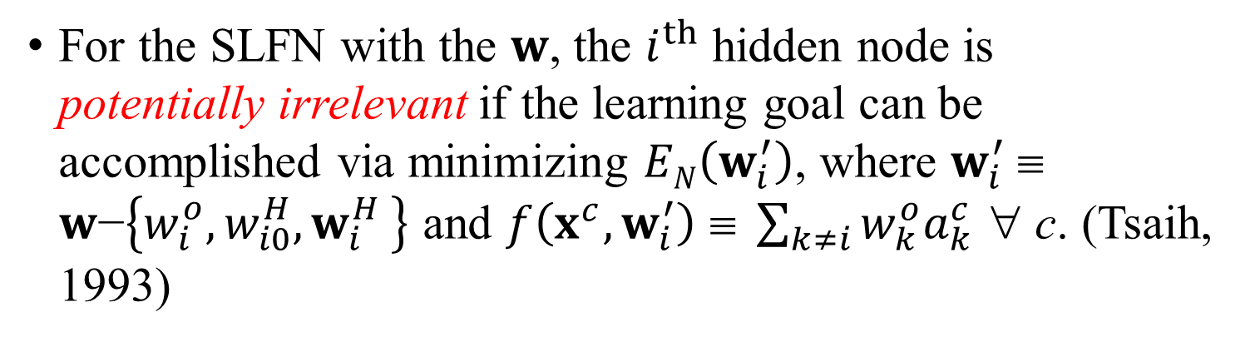
irrelevant hidden nodes & potentially irrelevant hidden nodes
The hidden node that can be pruned without making the learning goal unsatisfied is an irrelevant hidden node. (Tsaih, 1993)
For the SLFN with the $w$, the $i^{th}$ hidden node is potentially irrelevant if the learning goal can be accomplished via minimizing $EN\left(w_{i}^{′}\right)$, where $w_{i}^{′}$ ≡ $w\text{−}\left\{w_{i}^{o}{,w_{i0}^{H},w}_{i}^{H}\right\}$ and $f\left(x^{c},w_{i}^{′}\right) \text{≡ }\sum_{k≠i}{w_{k}^{o}a_{k}^{c}}$ ∀ c. (Tsaih, 1993)

Slide 3
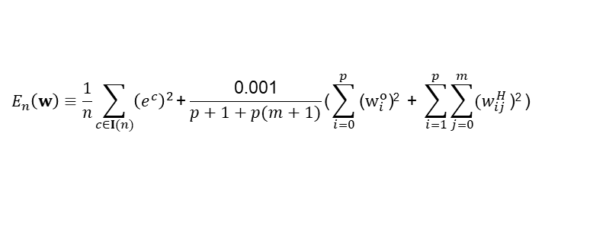
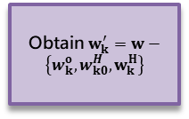
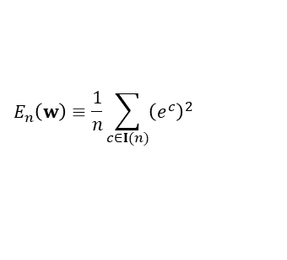
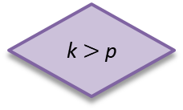
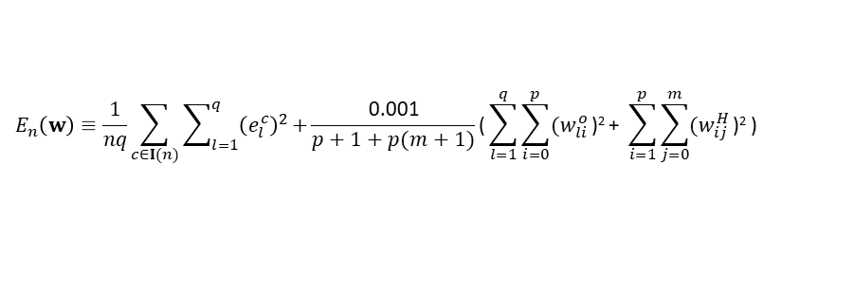
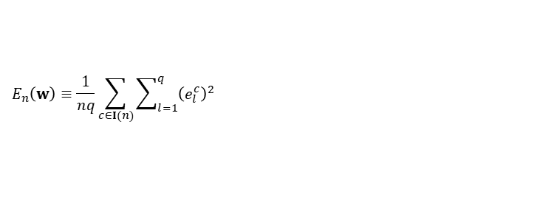
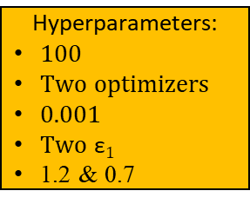
$$E_{n}\left(w\right)≡\frac{1}{n}\sum_{c∈I(n)}{{\left(e^{c}\right)}^{2}}$$
The reorganizing module
$$E_{n}\left(w\right)≡\frac{1}{n}\sum_{c∈I(n)}{{\left(e^{c}\right)}^{2}}\text{+}\frac{\text{0.001}}{p+1+p(m+1)}\text{(}\sum_{i=0}^{p}{\text{(}w_{i}^{o}\text{)}\text{2}}\text{ + }\sum_{i=1}^{p}{\sum_{j=0}^{m}{{(w}_{ij}^{H}}\text{)}\text{2}}\text{)}$$
$$E_{n}\left(w\right)≡\frac{1}{nq}\sum_{c∈I(n)}{\sum_{l=1}^{q}{{\left(e_{l}^{c}\right)}^{2}}}$$
Hyperparameters:
100
Two optimizers
0.001
Two $\text{ε}1$
1.2 & 0.7
The acceptability is determined by the learning goal
$$E_{n}\left(w\right)≡\frac{1}{nq}\sum_{c∈I(n)}{\sum_{l=1}^{q}{{\left(e_{l}^{c}\right)}^{2}}}\text{+}\frac{\text{0.001}}{p+1+p(m+1)}\text{(}\sum_{l=1}^{q}{\sum_{i=0}^{p}{{(w}_{li}^{o}}\text{)}\text{2}}\text{+ }\sum_{i=1}^{p}{\sum_{j=0}^{m}{{(w}_{ij}^{H}}\text{)}\text{2}}\text{)}$$
Restore the network and w
k ++
p --
A
B
An acceptable SLFN
k = 1
k $>$p
No
regularizing
Store the network and w
Obtain $w_{k}^{′}=w−\left\{{w_{k}^{o},w}_{k0}^{H}, w_{k}^{H}\right\}$
matching
Yes
An acceptable SLFN

Slide 4
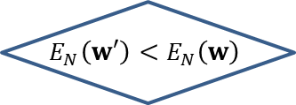


$$w_{k}^{′}=w−\left\{{w_{k}^{o},w}_{k0}^{H}, w_{k}^{H}\right\}$$
1
$$w$$
$$w_{k}^{′}$$
1
2
…
k
…
p
1
2
3
…
m

Slide 5
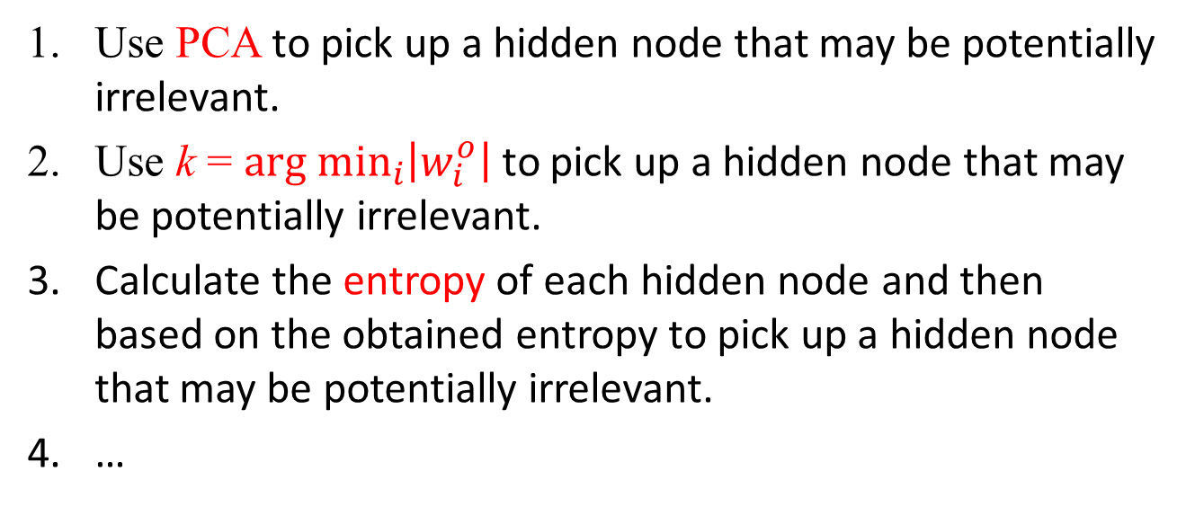
More ideas for the reorganizing module
Use PCA to pick up a hidden node that may be potentially irrelevant.
Use k = ${arg min}_{i}\left|w_{i}^{o}\right|$ to pick up a hidden node that may be potentially irrelevant.
Calculate the entropy of each hidden node and then based on the obtained entropy to pick up a hidden node that may be potentially irrelevant.
…

Slide 6
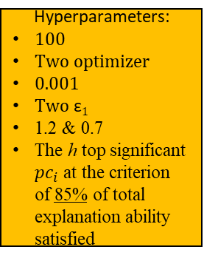
The reorganizing module with PCA
An acceptable SLFN
Regularizing
Hyperparameters:
100
Two optimizer
0.001
Two $\text{ε}1$
1.2 & 0.7
The h top significant ${pc}_{i}$ at the criterion of 85% of total explanation ability satisfied
The acceptability is determined by the learning goal
Store the network and w
PCA
Obtain $w_{k}^{′}=w−\left\{{w_{k}^{o},w}_{k0}^{H}, w_{k}^{H}\right\}$, where k = ${argmin}_{i}\left|ω_{i}\right|$
i = 1
i++
Forward operation
No
i ≥ 100
Learning goal
Backward operation
No
Yes
Yes
Restore the network and w
A new acceptable SLFN without the k^{th} hidden node
An acceptable SLFN

